Slide 1
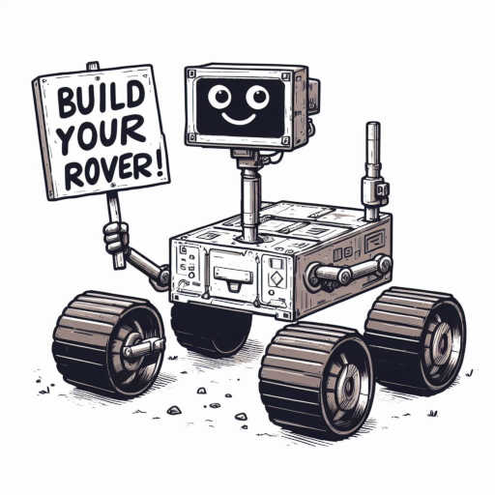
Design Presentation SCOUT ROVER
Team# 1
Prince Dr k Vasudevan College of Engineering and Technology, Chennai
8-february-2024

Slide 2
Outline
About Team
Problem Statement
Selected Concept Design
Block Diagram
Projection views of the proposed design
Bill of Material and Cost estimates
Gantt Chart – Project Plan
Open Issues
References

Slide 3
Team
Team Number:
SN | Student Name | Roll # | Year of Study | Department
1 | MANDALAPU SAMANTHA | 411621121016 | III | BME
2 | E.BARKAVI | 411621104006 | III | CSE
3 | V.JASHWANTH | 411621243028 | III | AI&DS
4 | S.SANTHOSH | 411622243030 | II | AI&DS
5 | G.HEMANTH RAJ | 411622243013 | II | AI&DS
SN | Faculty Name | Department
1 | Mrs ANITHA | AI&DS
 | Mrs VANITHA | AI&DS
Notes:
Few guidelines:
Preferably, pics/diagrams, tables etc. to be freshly prepared instead of taking from net. Few pics/diagrams in sample docs/slides to be hand-drawn and few could be drawn with machine/computer tools
Avoid copying text from net.
Components details/datasheet not required. Instead a reference link can be added, if required

Slide 4

Problem Statement
Rising occurrences of natural disasters and industrial accidents necessitate advanced technologies for effective disaster response and environmental monitoring. Traditional methods face limitations in accessibility and safety, prompting the need for innovative solutions like IoT rovers.
Notes:
Provide brief about problem/project being worked upon

Slide 5
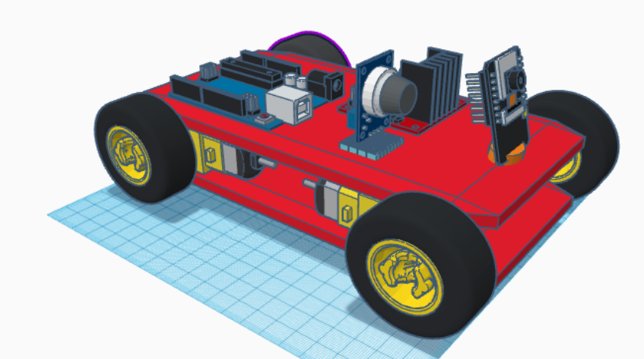
Concept Design
Introducing the "Scout Rover," an IoT rover designed for disaster response and environmental monitoring. Equipped with air quality, distance measurement, thermal, and microphone sensors, it monitors environmental conditions and detects hazardous substances in real-time.
The modular design allows easy integration and removal of sensors for customization. Mobile integration enables convenient control and data access via a user-friendly app.
With its robust design and advanced sensor capabilities, the Scout Rover empowers response teams to navigate hazardous terrain, gather vital data, and make informed decisions.
Notes:
Provide brief about selected concept in terms of visual diagram and textual points
Avoid copying pictures/text from net as it is. Visual diagram can be hand-drawn.

Slide 6

Concept Design
Key features include:
Suite of sensors for real-time environmental monitoring.
Modular design for flexibility and customization.
Mobile integration for convenient control and data access.
Empowers response teams in disaster areas and collapsed tunnels.
Reflects the spirit of adventure, resilience, and innovation.
Notes:
Provide key aspects of the design being considered wrt selected concept design

Slide 7
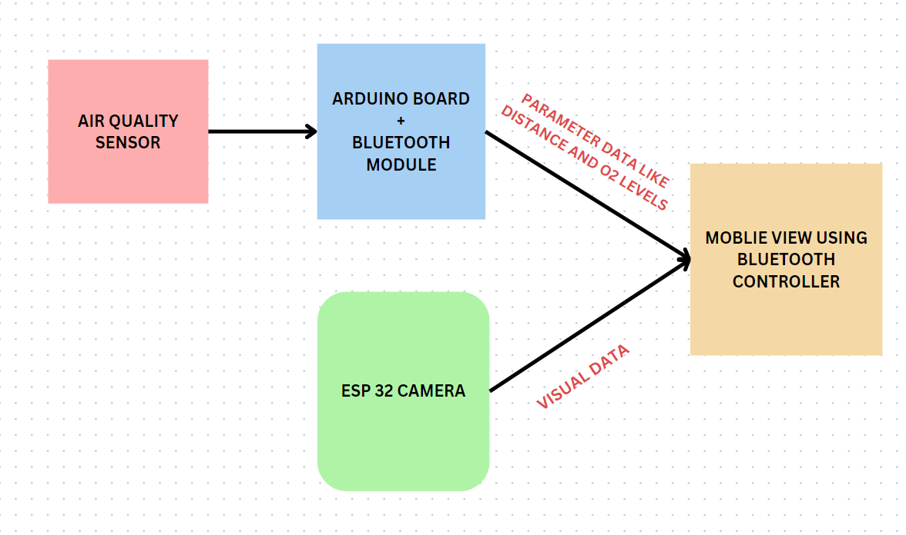
Block Diagram
Notes:
Provide block diagram covering functional blocks for selected concept design

Slide 8
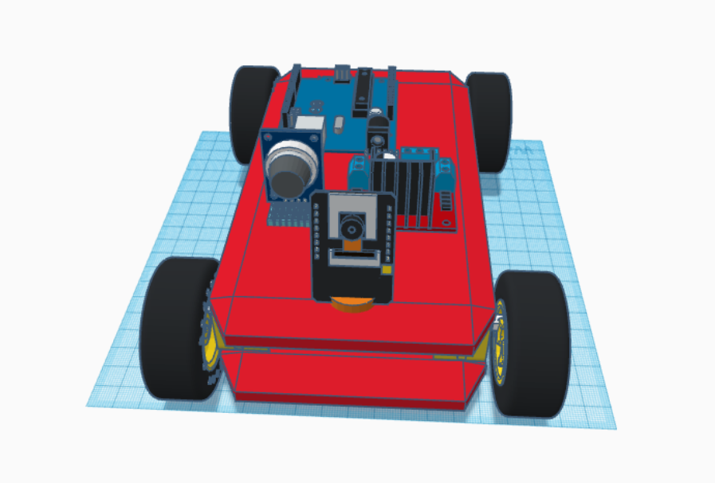
Our 3D view of scout rover
Notes:
For software, insert flowcharts, pseudo-code, data structures as appropriate
Add more slides as needed

Slide 9
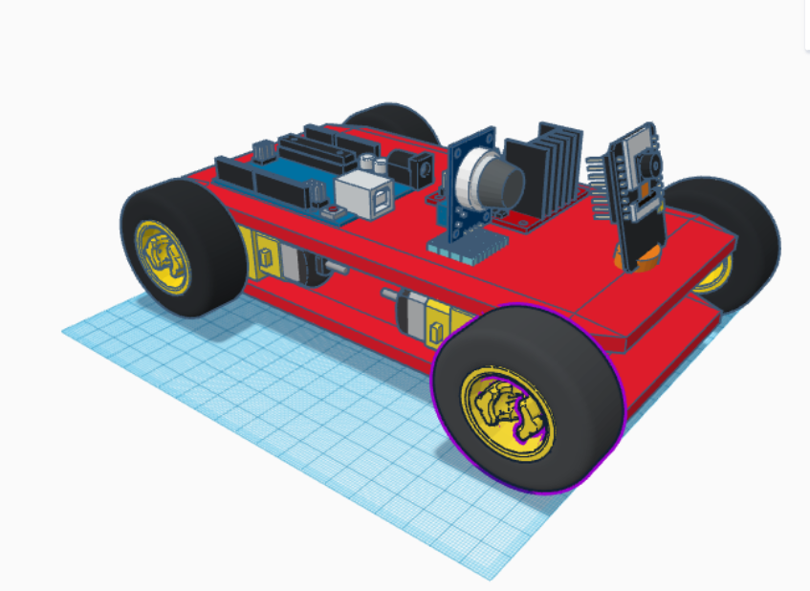
ROVER DETAILS
Arduino Uno
Esp camera
Air quality sensor(optional)
Chassis wheel
Dual Motor Controller

Slide 10
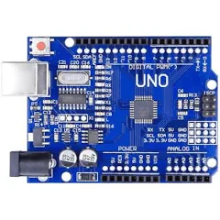
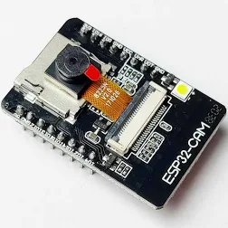
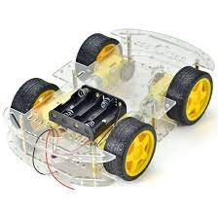
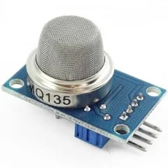
COMPONENTS DETAILS
ADRUINO UNO
AIR QUALITY SENSOR
ESP CAMERA
ROBUST CHASSIS
Serves as the microcontroller for sensor data processing, managing data acquisition, analysis, and transmission, providing intelligence and control for the rover's operations in disaster response and environmental monitoring missions.
Monitors air pollutants to ensure safety and assess environmental conditions, crucial for detecting harmful gases and ensuring breathable air quality in disaster scenarios and hazardous environments.
Provides a sturdy and durable framework, ensuring stability and resilience on rough terrain, enabling the rover to withstand harsh environmental conditions and traverse challenging landscapes with confidence.
Delivers live video feed for visual assessment, enabling real-time monitoring and analysis of disaster areas and collapsed tunnels, enhancing situational awareness and aiding response teams in decision-making processes.

Slide 11
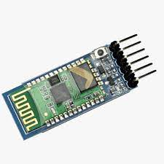
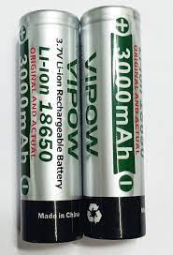
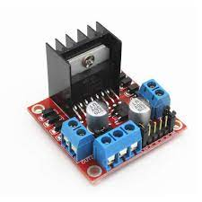
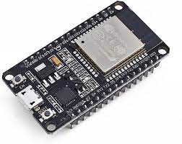
COMPONENTS DETAILS
BLUETOOTH MODULE
VIPOW 3000mah 3.7V
L2P8N MOTOR DRIVER
ESP32 WIFI &AMP
HC-05 Bluetooth module enables wireless communication between devices, facilitating remote control and data transmission. Widely used for IoT applications, it offers reliable connectivity and seamless integration for various projects.
"VIPOW 3000mAh 3.7V: lithium-ion battery commonly used in electronics. Capacity: 3000mAh, voltage: 3.7V. Ideal for smartphones, tablets, and portable chargers, providing rechargeable power."
The ESP32 is a widely used microcontroller featuring integrated Wi-Fi and Bluetooth capabilities, enabling IoT applications with wireless connectivity and versatile functionality.
"L2P8N motor driver is likely a specific model used in electronics. Further details such as manufacturer and specifications would provide clearer insight."

Slide 12
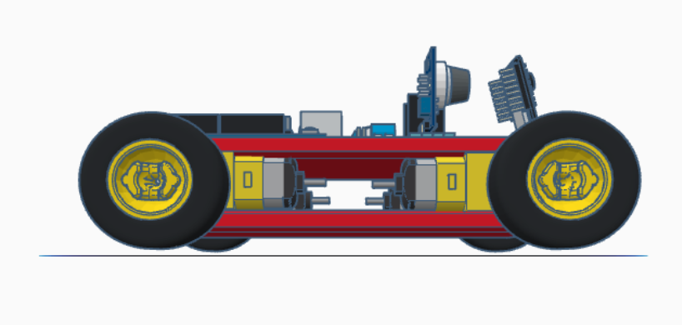
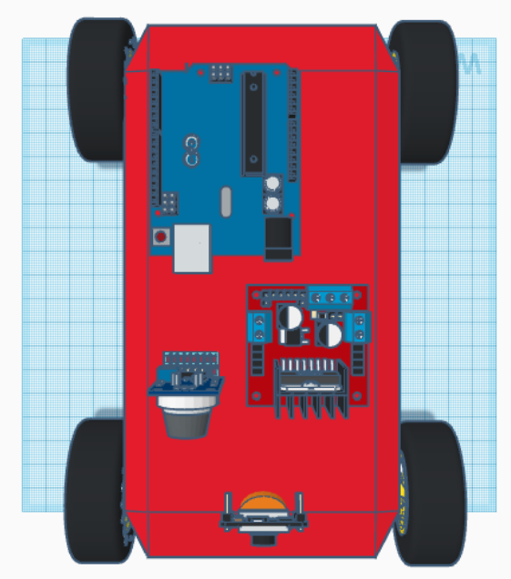
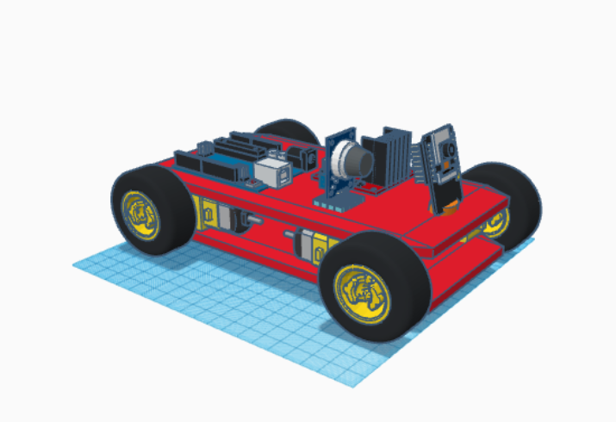
COMPONENTS DETAILS & 3D VIEW OF PROJECT
12

Slide 13


Slide 14
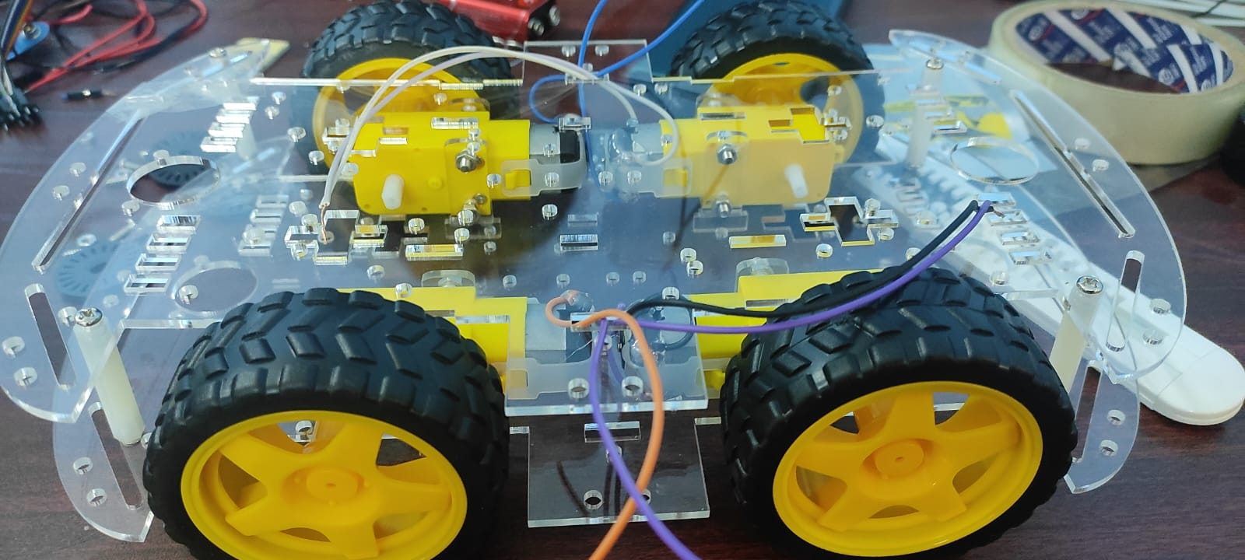
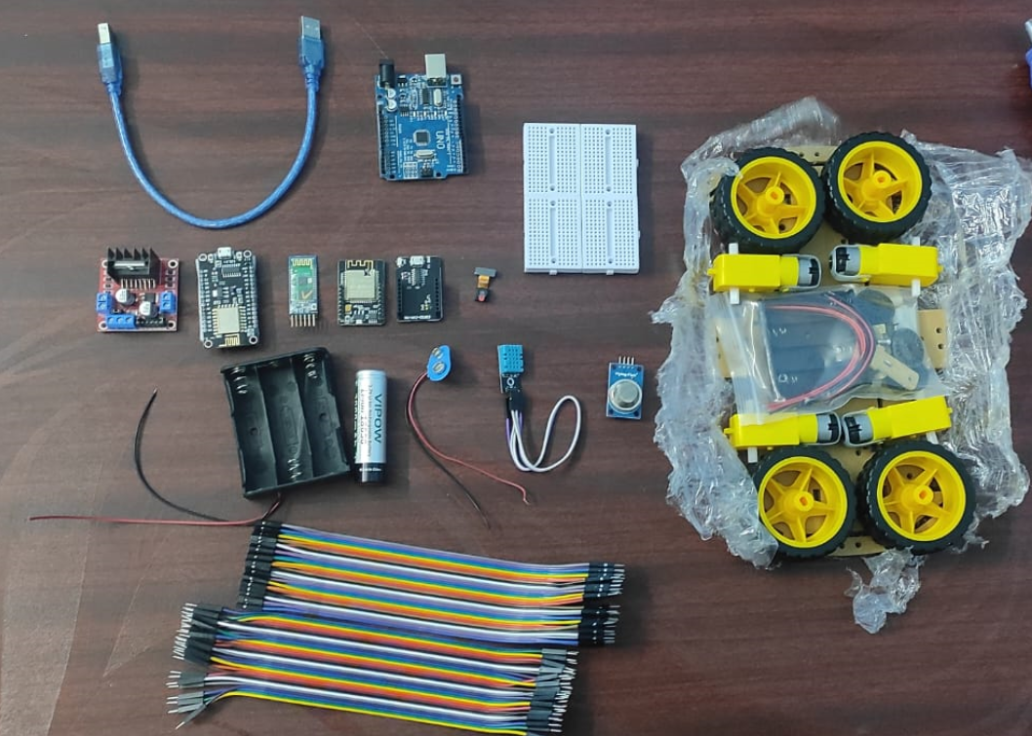
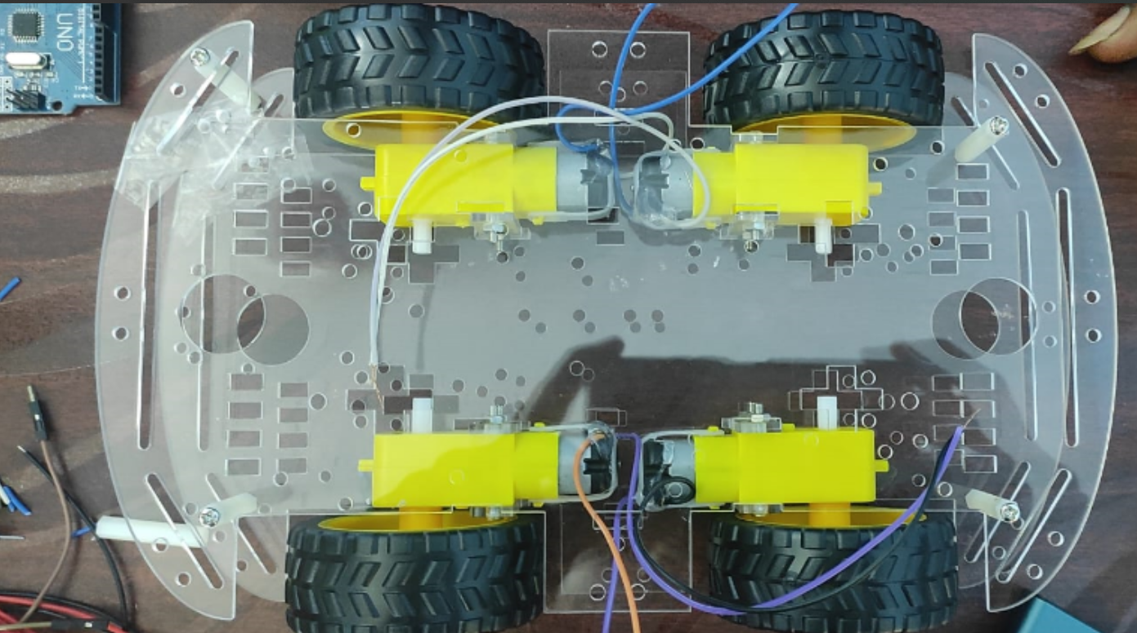
PROGRESS
Assembling Components: Begin by assembling the chassis, motors, motor driver, Arduino Uno, and other necessary hardware components to create the physical structure of the rover.

Slide 15
NEXT PROGRESS STATE
2. Placing Sensors:
Once the basic structure is assembled, strategically place the sensors such as the air quality sensor and ESP camera onto the rover. Ensure they are securely attached and positioned for optimal functionality.
3. Bluetooth Control:
Install a motor control app on your mobile device that allows you to control the rover's movements via Bluetooth. This app will communicate with the Arduino Uno on the rover to send commands for motor control.
4. ESP Camera Integration:
Install and integrate the ESP camera onto the rover, ensuring it is securely mounted and positioned to provide a clear view of the surroundings. Set up the necessary software to enable live video streaming and communication with the rover
5.Air Quality Sensor and ESP WiFi Module
Finally, place the air quality sensor and ESP WiFi module onto the rover. Ensure they are connected to the Arduino Uno and positioned to accurately monitor air quality and enable WiFi communication for data transmission.

Slide 16
EXTRA FEATURE OF ROVER
Using the rover with multiple functionalities enhances its versatility and applicability in various scenarios:
1. Cargo Functionality : Enables the rover to transport supplies, equipment, or rescue materials to disaster-stricken areas or remote locations efficiently.
2. Distance Measurement : Provides accurate distance readings, aiding in navigation, obstacle avoidance, and mapping of disaster sites or hazardous environments.
3. Temperature Measurement : Monitors temperature variations, crucial for assessing environmental conditions, identifying potential hazards, and ensuring the safety of personnel and equipment.
4. Microphone : Records ambient sounds and voices, enhancing situational awareness, facilitating communication, and enabling remote monitoring and coordination in disaster response operations.
incorporating these functionalities, the rover becomes a versatile tool capable of addressing a wide range of challenges and requirements in disaster response, environmental monitoring, and exploration missions.

Slide 17
Bill of Material (BOM) and Cost Estimate
S.NO | COMPONENTS | UNIT COST | TOTAL COST
1 | 4 WHEEL CHASIS KIT | 790 | 790
2 | 18650 VIPOW BATTERY | 160*3 | 480
3 | 18650 3 CELL HOLDER | 55 | 55
4 | ESP32 CAMAERA MODULE | 590 | 590
5 | L2P8N MOTOR DRIVER | 150 | 150
6 | HC-05 BLUETHOOTH | 310 | 310
7 | MQ2 CAL SENSOR | 155 | 155
8 | ADRUINO UNO R3 | 490 | 790
9 | JUMPER WIRE | 20*3 | 60
10 | BREAD BOARD | 25 | 25
11 | ESP32 WIFI&AMP | 390 | 390
 | TOTAL |  | 3795
Notes:
Provide bill of material including cost estimate, based on parts required to build the project as per selected design
We can also add reference links for purchasing material

Slide 18
Gantt Chart -- Project Plan
Task/Activity | Wk3 | Wk4 | Wk5 | Wk6 | Wk7 | Wk8 | Wk9 | Wk10 | Wk11
Wk start date | 16-Mar | 11-May | 11-Jul | 18-Jul | 25-Jul | 1-Aug | 8-Aug | 15-Aug | 22-Aug
Wk end date | 22-Mar | 17-May | 17-Jul | 24-Jul | 31-Jul | 7-Aug | 14-Aug | 21-Aug | 28-Aug
List 3 design alternatives
Freeze on one design
Design Presentation/ Review
Detailed design, BOM, place orders
Implementation and Testing
Notes:
Provide a high level Project plan for developing the prototype for your selected design. Keep in mind the weekly schedule of LP201 and ensure that the completion dates are sufficiently before the LEAP deadlines!

Slide 19
Gantt Chart -- Project Plan ..contd
Task/Activity | Wk3 | Wk4 | Wk5 | Wk6 | Wk7 | Wk8 | Wk9 | Wk10 | Wk11
Wk start date | 16-Mar | 11-May | 11-Jul | 18-Jul | 25-Jul | 1-Aug | 8-Aug | 15-Aug | 22-Aug
Wk end date | 22-Mar | 17-May | 17-Jul | 24-Jul | 31-Jul | 7-Aug | 14-Aug | 21-Aug | 28-Aug
Demo, Open house preparation
Open house
Closure Project Report Feedback Settling bills Returning tools/ equipment ..
Notes:
Provide a high level Project plan for developing the prototype for your selected design. Keep in mind the weekly schedule of LP201 and ensure that the completion dates are sufficiently before the LEAP deadlines!

Slide 20
Open Issues
LIMITED SPACES
POWER CONSTRAINT
DAMAGE DUE TO ENVIRONMENTAL HAZARD
LIMITED WEIGHT CAN BE PLACED IN CHASIS ROVER
Notes:
Highlight open issues, if any, for which you do not have answers/solutions at present.
Also, suggest by when these open issues are to be resolved if they are critical for project execution.

